Slide 1

SATs
2020-21

Slide 2
Changes for 2020
Year Two Tests
The tests reflect the new curriculum
They will take place in May – only!
The tests will not be timed
There will be four different papers
Writing standards are not “all” on a tick list more a “best fit” model with greater emphasis on composition.

Slide 3

Reading

Slide 4
READING
All children will complete both papers Paper 1 50% approximately 20 marks (30mins)
The paper will have a selection of texts
containing approximately 400-700 words
Paper 2 50% approximately 20 marks (40mins)
There will be a reading booklet containing approximately 800-1100 words and a separate answer sheet booklet.

Slide 5
Examples of the style of the tests
The teachers will be advised of the timings although these are approximate
The tests will contain fiction, non-fiction and poetry and the questions will get harder as the test progresses
Teachers will be allowed to stop the test for a child who is struggling to answer.

Slide 6
Information
The format of the answers will be similar to previous years (We will do lots of similar work in class with them so don’t worry.)
Matching boxes to text
Multiple choice
Labelling
Finding a word that means a particular thing
Open ended questions

Slide 7
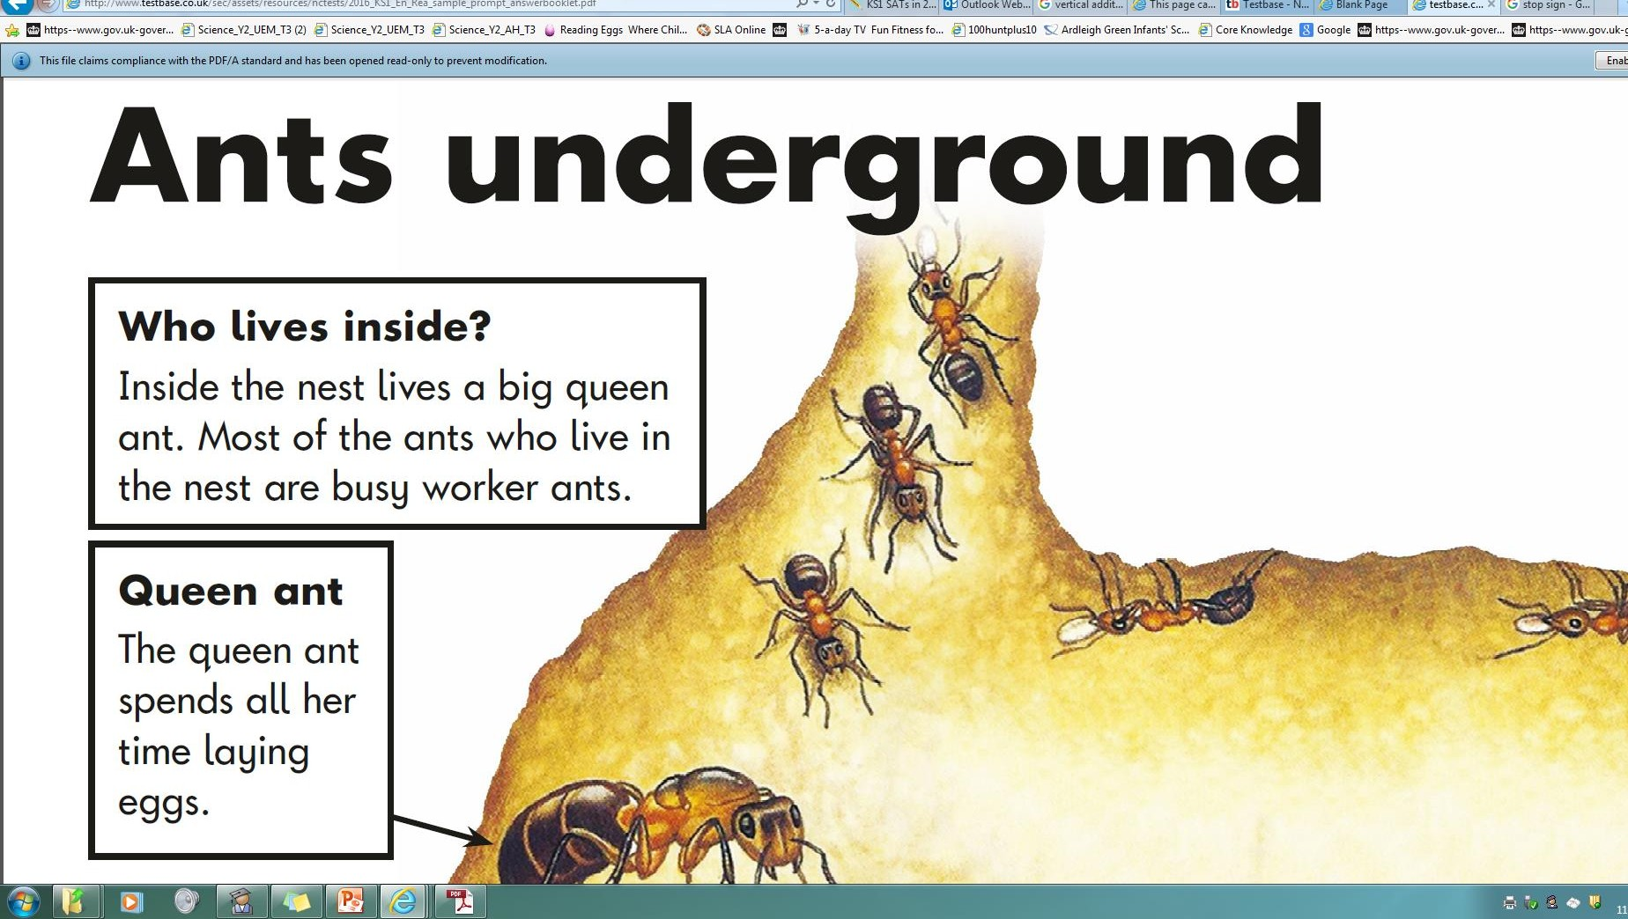

Slide 8


Slide 9

Spelling,
Grammar and
Punctuation

Slide 10
Spelling
Paper 1
This will be given to all children and will include
Listening to a sentence and adding a word (spelling must be accurate – 20 words in all)
A guide time of 15-20 minutes – not dissimilar to previous years

Slide 11
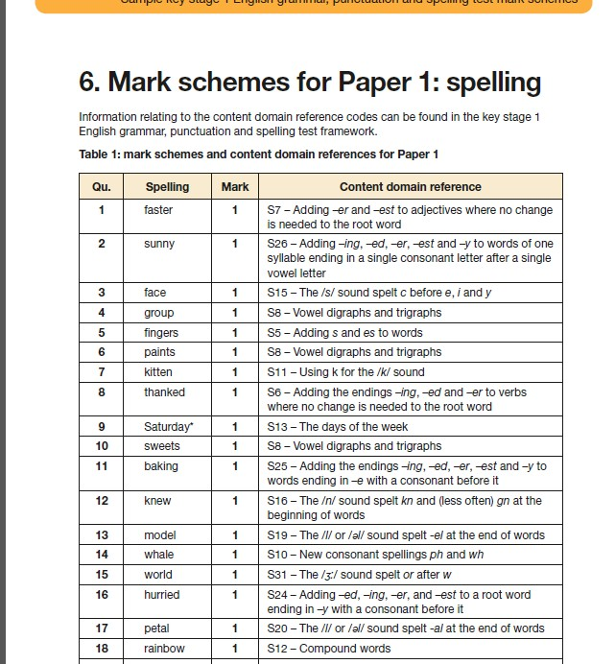

Slide 12

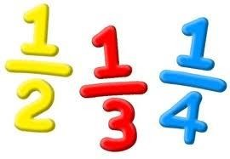
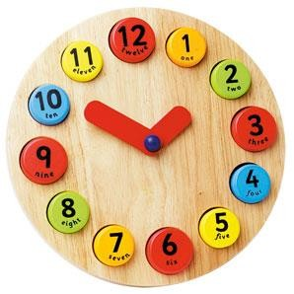
Maths

Slide 13

Maths
There will be Two Papers
These will be given to all children and will include
Paper 1 – Arithmetic – around 25 marks Confidence and accuracy of answering questions (e.g.: adding 3 one-digit
numbers etc.)
It will cover the four basic rules of addition, subtraction, multiplication and division.

Slide 14
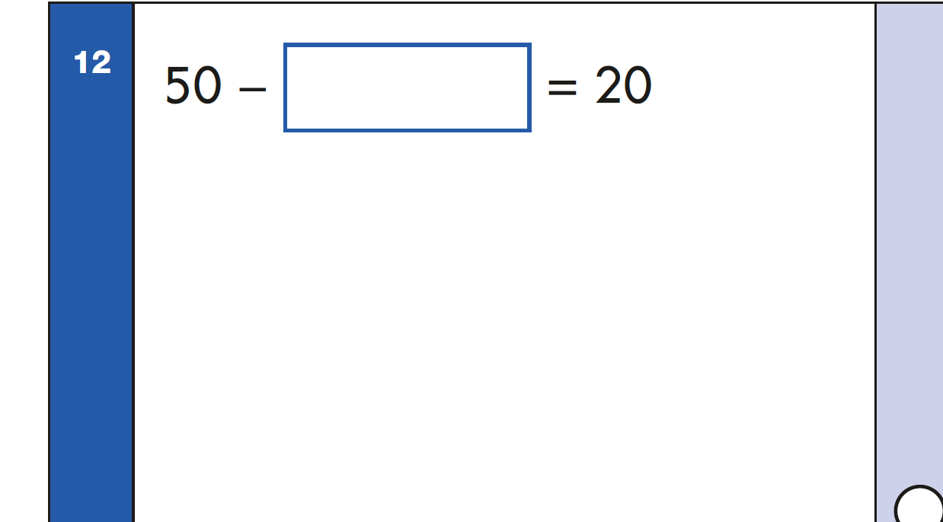

Slide 15
Maths
There will be Two Papers
Paper 2 – Reasoning around 35 marks
Multiple choice containing various types of questions:
true or false
completing tables or charts
money calculations and problems above
£1
word problems etc.

Slide 16
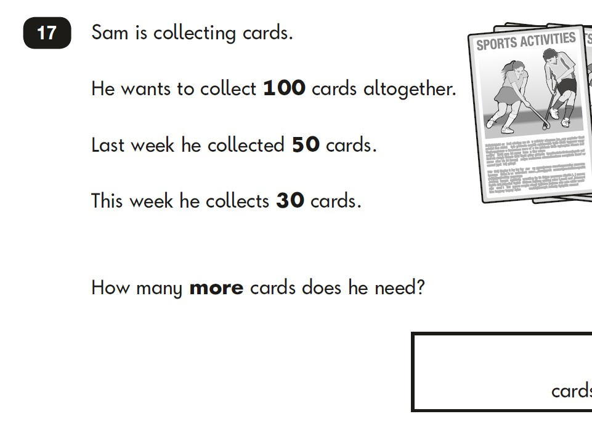

Slide 17

No equipment - 100 squares, cubes, or number-lines not to be used!

Slide 18
Reporting to Parents
Your child will be given a grade telling you if they have reached the expected standard. Children will be given a standardised score.
You will be told, prior to the end of the year if your child is below the expected standard so you should not be shocked.
Look on our website at our Engayne End of Year Expectations (the expectation is very high)
These are used by teachers to assess your child.

Slide 19

Please support your child all year. Read to and with them to aid vocabulary, pace and expression (3 x a week). Look at the kind of questions that your child will be expected to complete at KS1. Letter to follow with CPG books for support.
HOW CAN YOU HELP?....
Attendance and punctuality are an essential part of success. The curriculum is pacey. Assembly time is used to assist the children.
Do not pressurise your child – be positive.
Please visit our website to see our Calculations Policy and the link to KS1 past papers and revision games.
http://www.satspapers.org.uk/Page.aspx?TId=4
http://www.bbc.co.uk/bitesize/ks1/maths/
Thank you so much for your support.

