Slide 1

Welcome to Year 2

Slide 2
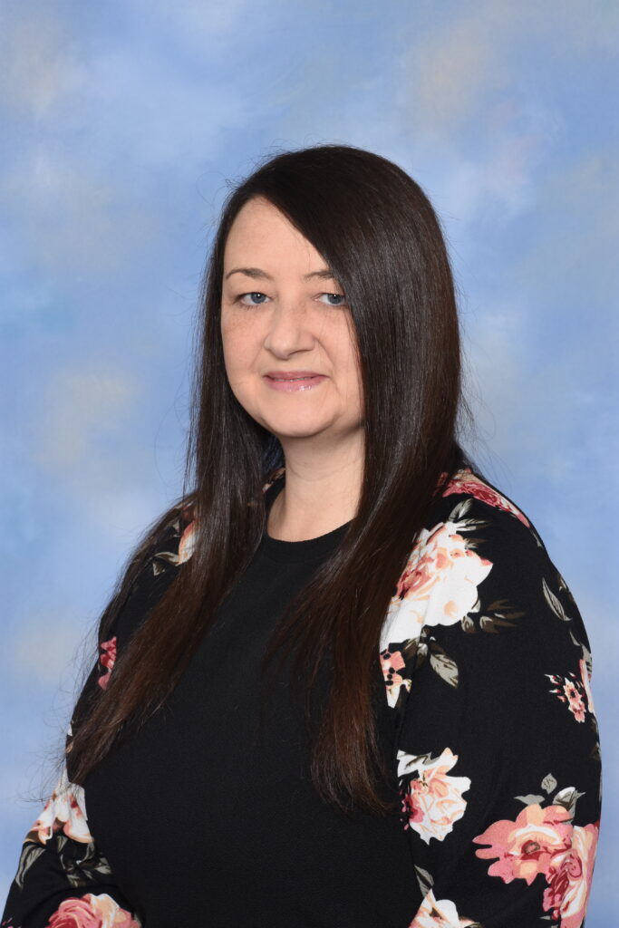
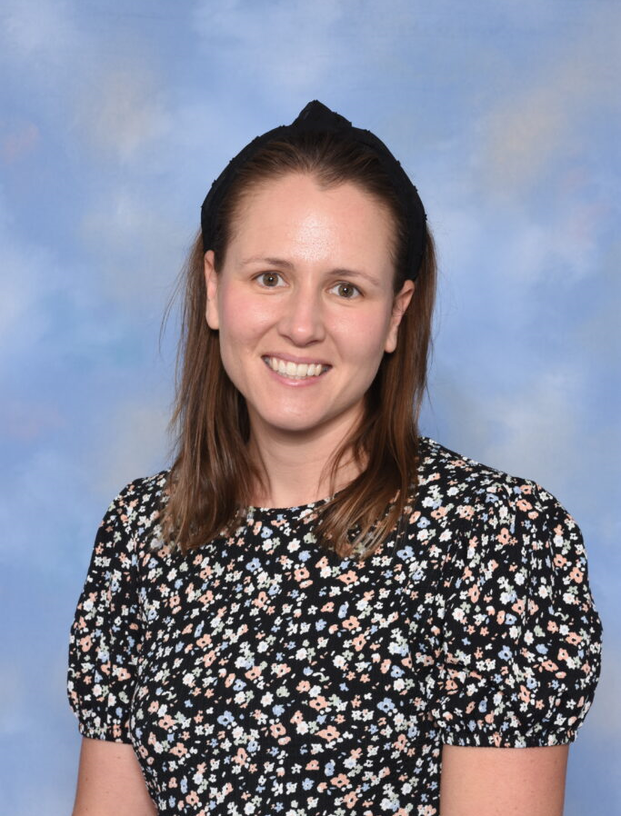
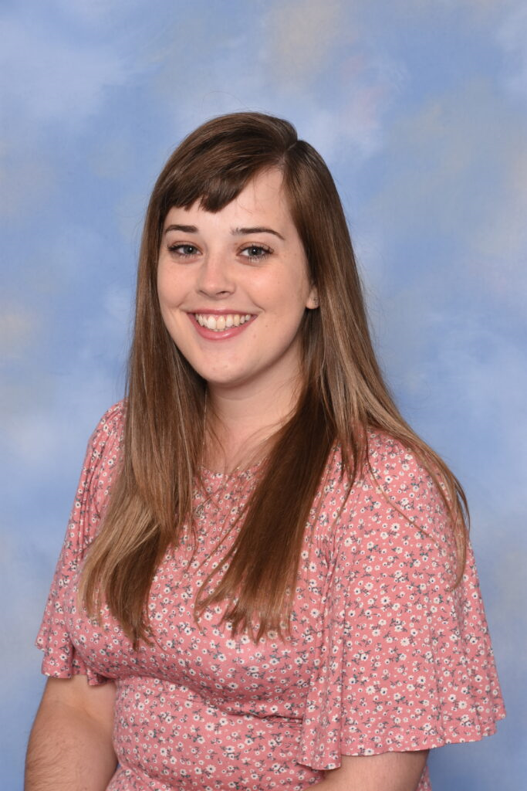
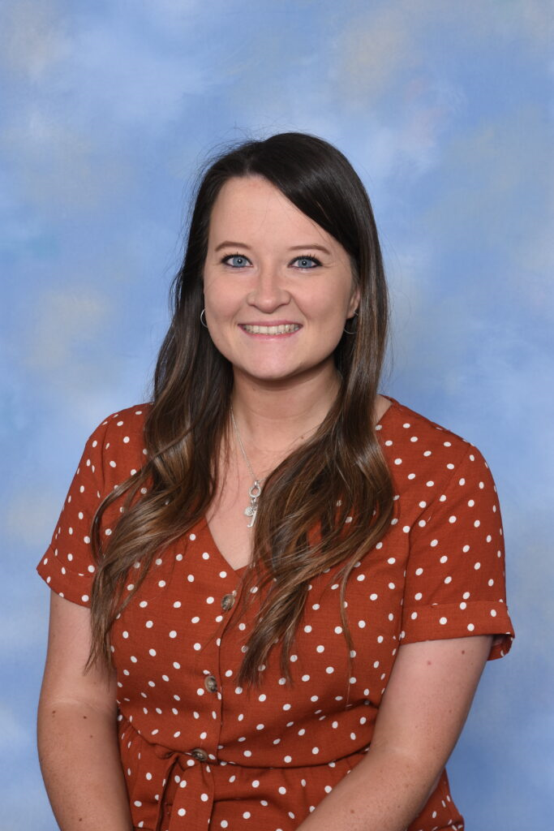
Year 2 Teachers
2B | 2J | 2M
Miss Burke Mrs Brown | Miss Jupp | Miss Monaghan

Slide 3
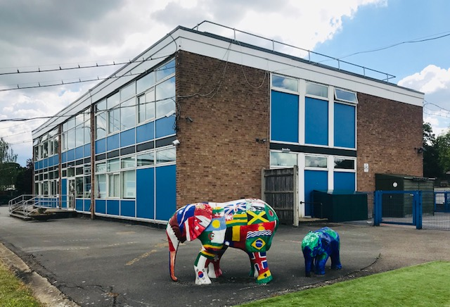



The Year 2 classrooms are in the Annex building, next to the Reception garden. It is also where the Infant Library is.

Slide 4
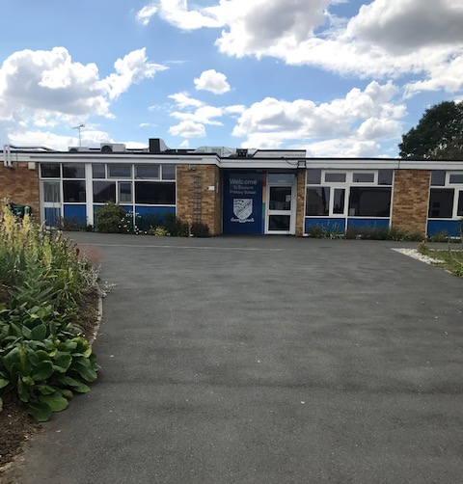
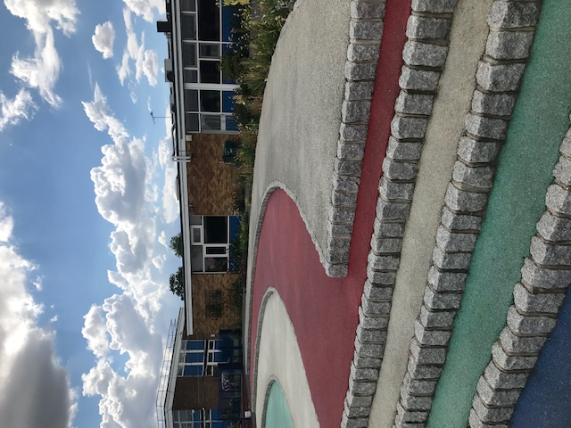
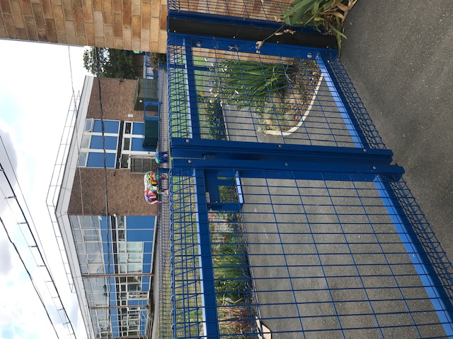
Walk up the path, past the rainbow steps to the blue gate and follow the path to the Annex building. A friendly face will be at the gate to say Good morning.

Slide 5
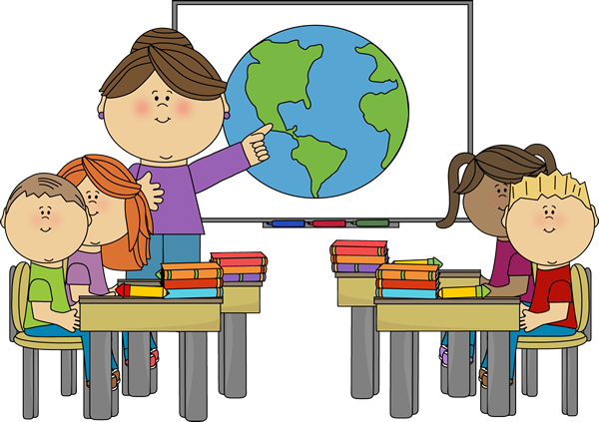

Have a look inside your classrooms.
We cannot wait to welcome you all.

Slide 6
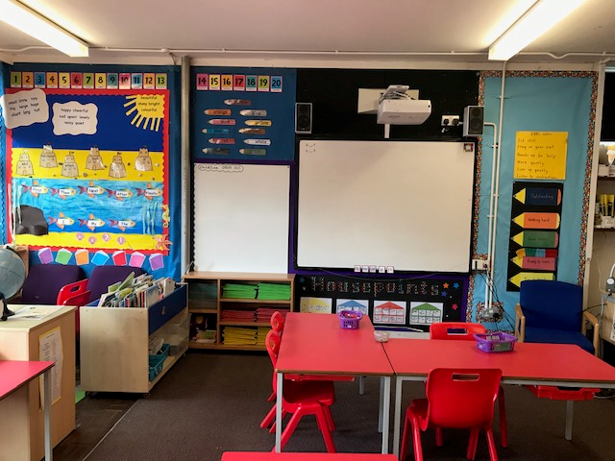
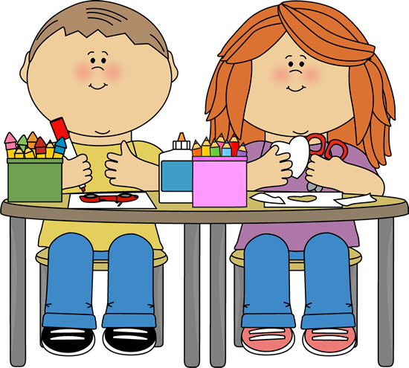
2B

Slide 7
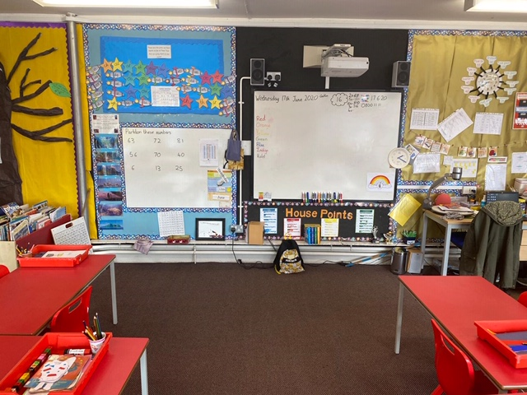

2J

Slide 8
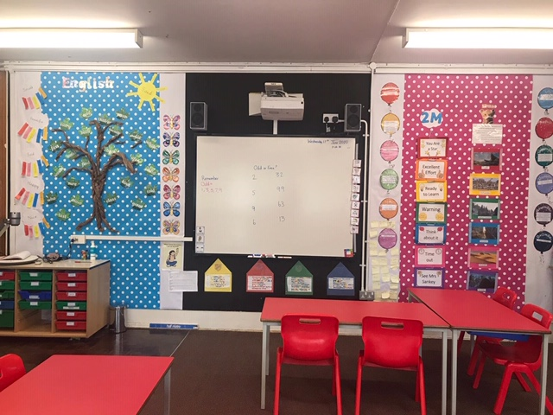
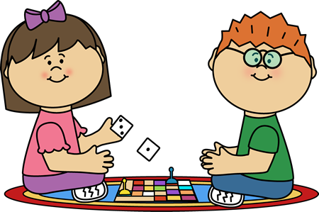
2M

Slide 9
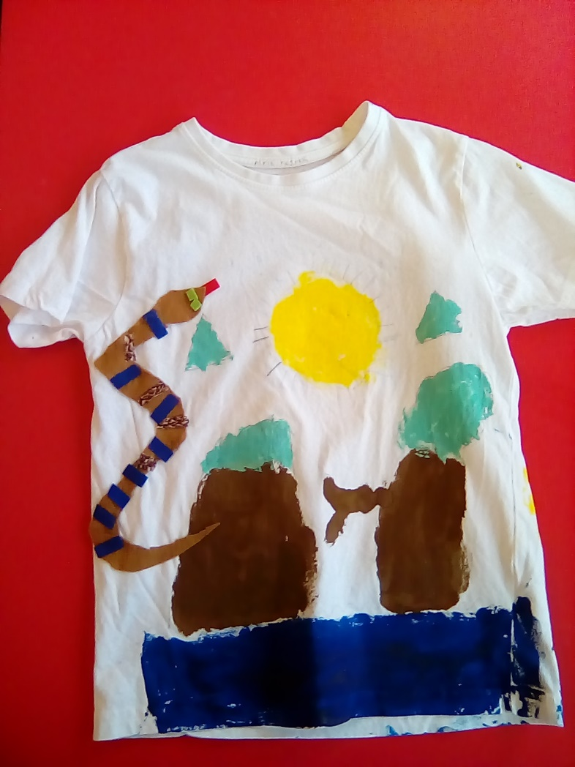
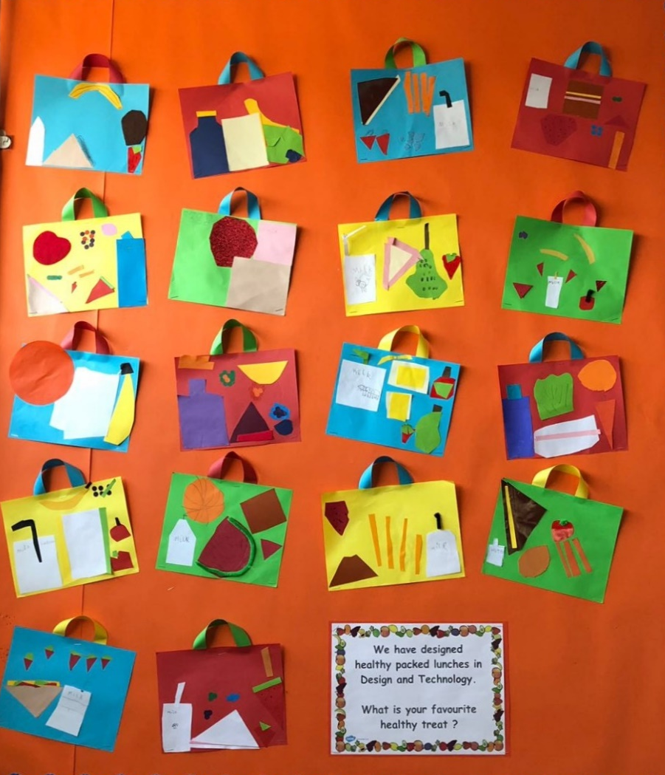
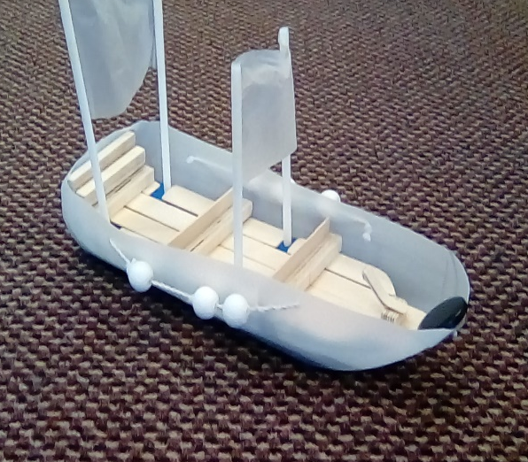
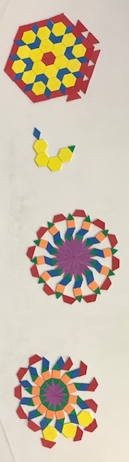
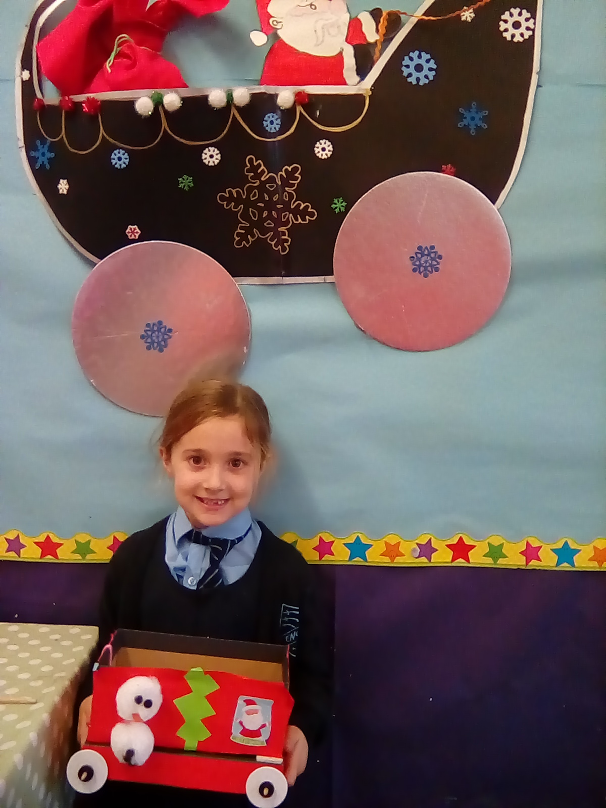
In Year 2 we love to invent, build and design.

Slide 10
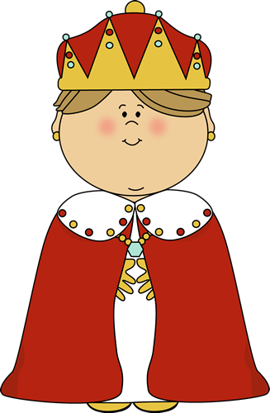
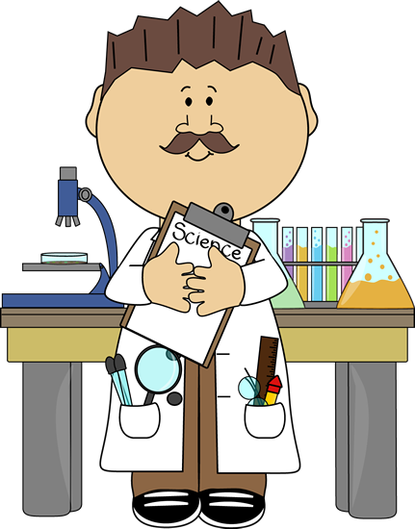
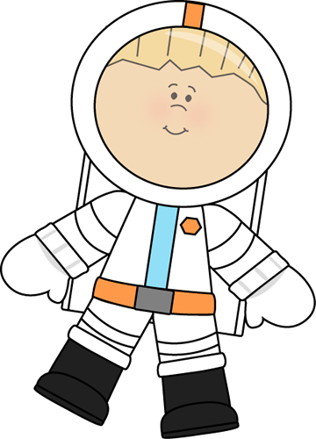
Join us as we go back in time, to learn about famous people and events from the past.

Slide 11


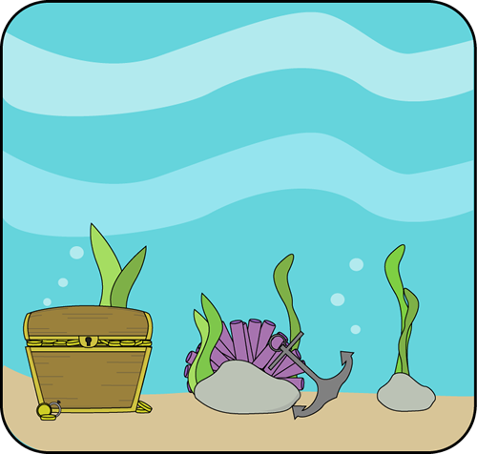
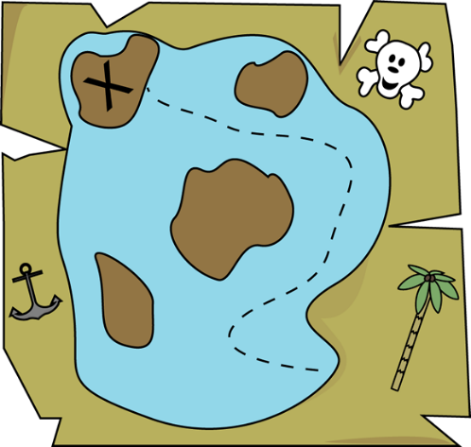
Where will our exciting reading adventures take us ? We love to use our imaginations.

Slide 12
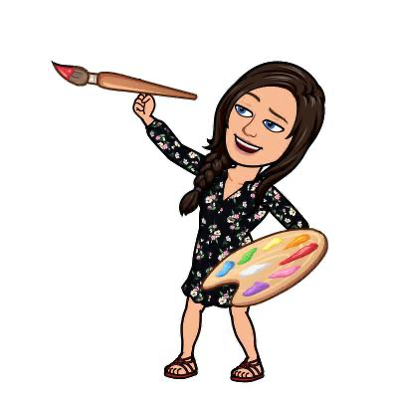
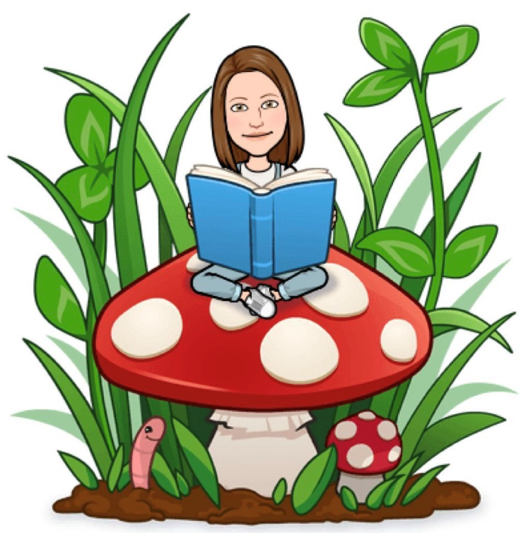
Our favourite things are…
Mrs Brown really likes reading and being outdoors.
Miss Burke especially enjoys
Art and DT.

Slide 13

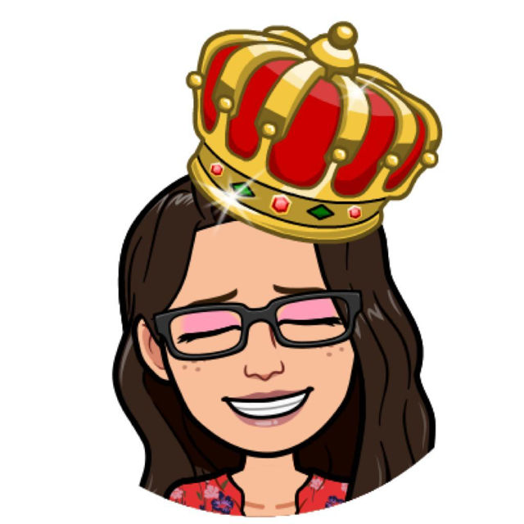
We enjoy…
Miss Jupp loves Music, it is one of her favourite things.
Miss Monaghan loves History, imaging what life was like in the past.

Slide 14

We look forward to sharing an amazing time together in Year 2. Have a lovely Summer.
From Miss Burke, Mrs Brown, Miss Jupp and Miss Monaghan.

