Slide 1

Transition
EYFS to Year 1

Slide 2
Thank You
We are very proud of the progress the children have made and thank you for all your support.

Slide 3
Early Learning Goals
The EYFS profile requires practitioners to assess children against a set of 17 early learning goals (ELGs).
Working towards
Expected

Slide 4
EYFS …(move away from child-initiated learning)
In Foundation Stage, each area of learning and development is implemented through planned, purposeful play and through a mix of adult-led and child-initiated activity.
Children learn by leading their own play, and by taking part in play which is guided by adults. There has been a balance between activities led by children, and activities led or guided by adults.
As children grow older, and as their development allows, it is expected that the balance will gradually shift towards more activities led by adults, to help children prepare for more formal learning, ready for Year 1.
Notes:
The above statements come from the Statutory Framework paragraph 1.9
In order for children to have opportunities to develop the characteristics of effective learning, they need lots of opportunities to be involved in self-initiated learning.
Child initiated learning is the action of a child choosing to extend, repeat or explore an activity.
This activity may or may not have been introduced or prompted by an adult – it is the child’s innovation which makes it self-initiated.
Child-initiated learning provides practitioners with a opportunity to observe what children are able to do consistently and independently, but practitioners should not spend all of their time during child-initiated learning just observing children. We know that adult interactions help children make links in their learning and practitioners need to respond with fluidity and sensitivity and actively seek out opportunities for meaningful interaction with children.
Adults can and should be present and supportive during child-initiated learning but not directive. For example an adult may be supporting a child to realise an idea by providing necessary resources or by engaging in thought provoking conversation.
There is still a place for adult directed and adult led teaching but in the early stages of the EYFS this is likely to be limited to short key person and small group activities such as stories, songs and games.
In reception there will be an increasing balance of adult-led and child-initiated activities – for example explicit teaching of literacy and mathematical skills but children will still needs lots of opportunities to apply and rehearse these skills in their child initiated learning in order to embed and apply their knowledge and understanding.

Slide 5
Year One
Expectations: Children will be working in small groups with adult support. During this transition period there will be lots of practical/child initiated activities. We also have use of our outdoor area with a canopy next to the Year 1 classes.
After the first term some children are able to work more independently and rely less on adult support. By the end of the year the majority of children can complete work with a high level of independence.
In September all Year 1 children will swim weekly in 2 groups. Practise changing for swimming independently. A note will be distributed to inform you of when your child will be swimming in the first week back. Please name all items of clothing.
Writing independently: Children are encouraged to use their sounds and write using scaffold sheets to support them. This will be done in small groups with adult support.

Slide 6
Phonics: The children will continue to have daily phonics lessons. In Year 1 all children are tested in reading 40 words real and alien in June ( Phonics screening check). We track and test children throughout the year. The pass mark this year was 32. Teach your monster to read and phonics play are free resources that you can access from home to support your child.
Spellings are given in year 1 which usually consist of 5 words. These will be a mix of either words from the Year 1 high frequency word list or words that practise a spelling pattern e.g. ar, er. Children learn these at home and will be tested on these in class.
Homework is sent out on Friday and is due back Wednesday. This consists of Reading at least 3x per week, spelling lists, website work (times tables 2’s, 5’s and 10’s) and sometimes a topic based learning activity (e.g. growing a seed and making a seed diary).

Slide 7

Friday 27th September 2:30pm
We would like to invite you to a ‘Tiger Tea Party’
In September, the children will write invitations to you, inviting you in for a tea party on Friday afternoon.

Slide 8
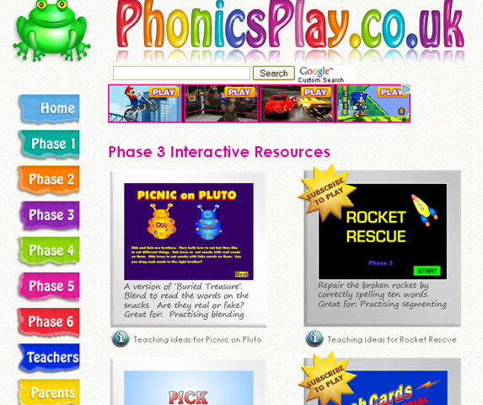
Phonics Screening
Children are tested at the start of the year on their phonics. (Digraphs)
Continue to play games over the holidays and practise High Frequency Words in word wallet.
For example;
I Spy

Slide 9


Summer Holiday Activities
Suggested activities for the children to complete over the summer holidays will be sent home in the last week of term.
Literacy
Maths
Creative

Slide 10
Summer Slide
It is characterised by steady progress in reading achievement throughout the school year, and a decline during the long summer holidays. Away from school, some students spend less time reading and miss out on:
access to books and other reading resources
reading practise
encouragement to read
role modelling
support for reading

Slide 11
Reading
Make reading enjoyable for the children, keeping reading fun with easy and self-selected material, talking about books, sharing books and reading time
Read aloud to your child
Make time for reading every day – little and often
Help your child choose “just right books”
Let the children see you as reading role models.
Encourage them to read independently
Include some enjoyable literacy activities such as writing letters or postcards, reading recipes
Manage electronic entertainment at home -“turn off the TV or Playstation” and reward reading
Make regular trips to the public library and letting children choose books and magazines (Summer reading challenge)
All children will have ‘Bug Club’ books allocated for the holidays. Their logins will be active over the holiday period.

Slide 12

Have a lovely summer

